Slide 1

ASL Project —— Improved Smoothed-Particle Hydrodynamics Mengdi Wang, Silvia Nauer, Tianwei Yu, Valérie Kulka
TexPoint fonts used in EMF.
Read the TexPoint manual before you delete this box.: AAAAA

Slide 2
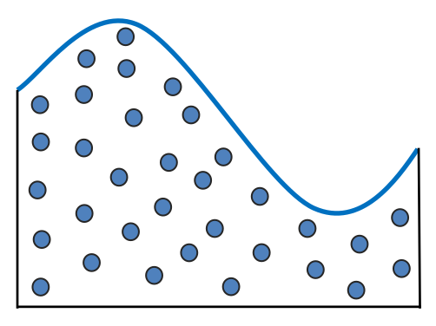
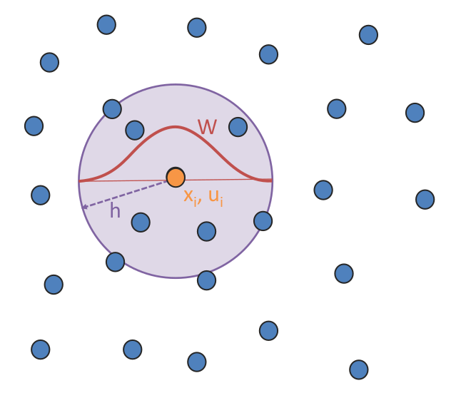
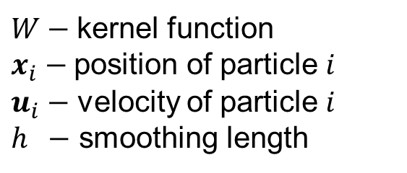
SPH Algorithm description
$W−$ kernel function
$x_{i}−$ position of particle $i$
$u_{i}−$ velocity of particle $i$
$h −$ smoothing length
Images taken from lecture slides “10_FluidsIII_SPH.pdf” of the course Physically Based Simulation in Computer Graphics, AS 2018.
Author: Barbara Solenthaler, Computer Graphics Laboratory, ETHZ.
Notes:
Fluid is discretized by particles, which represent a certain amount of fluid volume.
Every particle has a mass, a position, a velocity, an acceleration, a density and a pressure.
Every particle has also neighbors. The displacement of the particles and their related quantities are influenced by the neighborhood. The influence is weighted, with factor W, depending on the position of the neighbor’s particles.

Slide 3

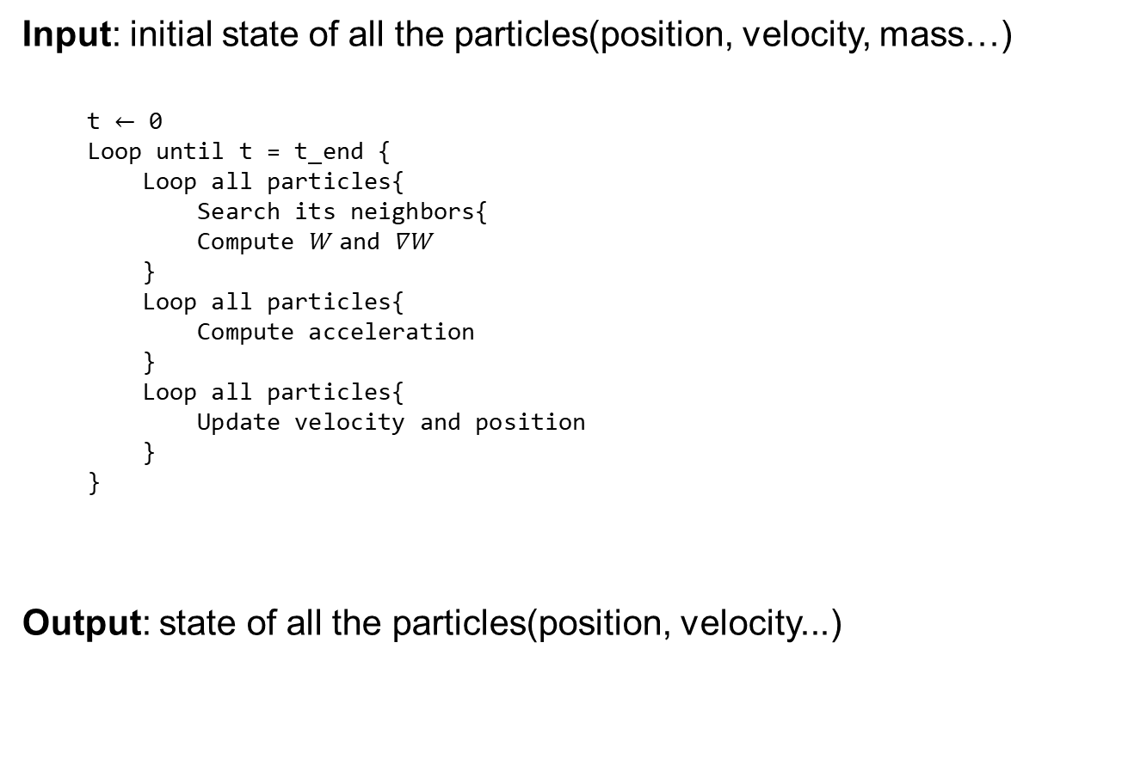

SPH Algorithm description
Input: initial state of all the particles(position, velocity, mass…)
t $←$ 0
Loop until t = t_end {
Loop all particles{
Search its neighbors{
Compute $W$and $∇W$
}
Loop all particles{
Compute acceleration
}
Loop all particles{
Update velocity and position
}
}
Output: state of all the particles(position, velocity...)
$$O(N^{2})$$
$$O(N)$$

Slide 4
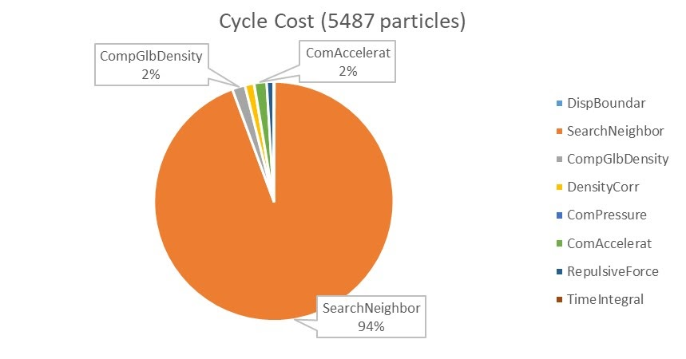
SPH Algorithm description

Slide 5
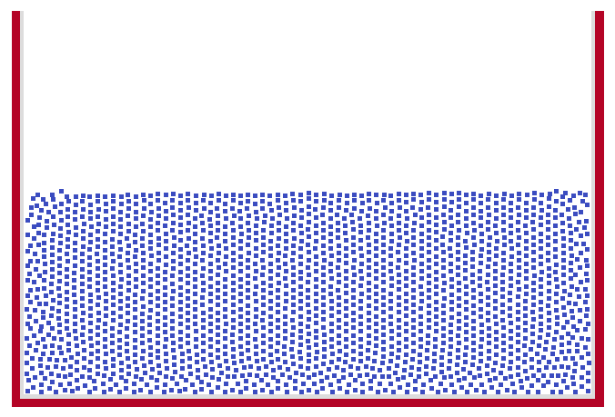
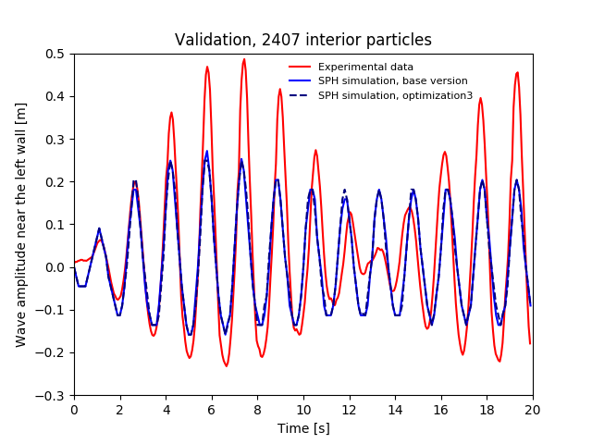
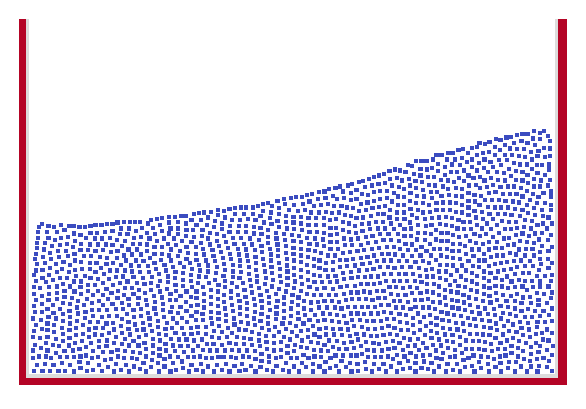
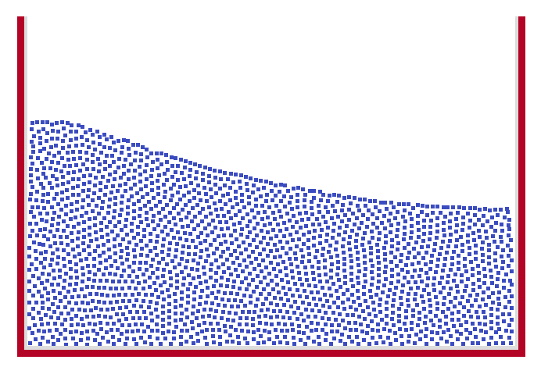
Simulation and Validation
Experimental data are provided by Odd M. Faltinsen and are the ones shown in Fig. 6(a) of “Multidimensional modal analysis of nonlinear sloshing in a rectangular tank with finite water depth”, Faltinsen et al., Journal of Fluid Mechanics, Vol.407
Notes:
Possible reasons for errors:
We did not implement a method in order to simulate turbulence
The authors of the paper which we refer to, used 40000 particles in order to get results compatible with experimental data. The plot on the left is only for ca. 4000 interior particles.
However, the period of the oscillations is in accord with experimental data, which is enough for us to validate our algorithm (at least for the ASL project).

Slide 6
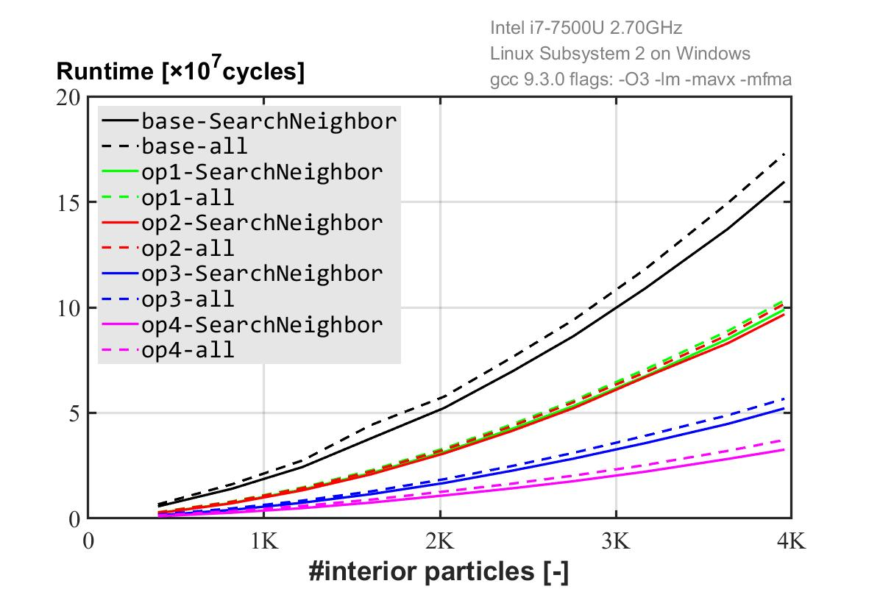
Runtime
Base version
+ data structure
+ inlining
+ scalar replacement
+ reducing branches
Optimized version 1
+ unrolling
+ blocking
Optimized version 2
+ vectorization
Optimized version 3
+ postpone sqrt
Optimized version 4

Slide 7
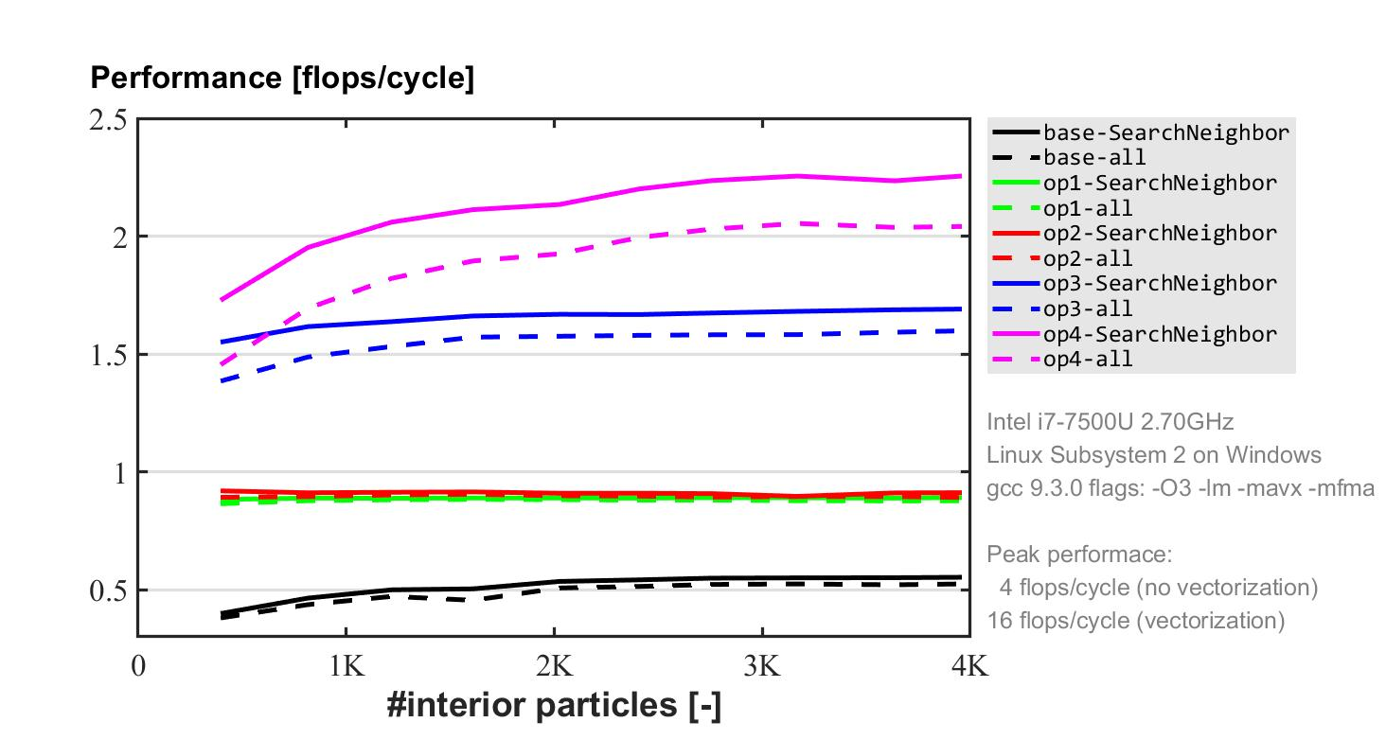
Performance

Slide 8
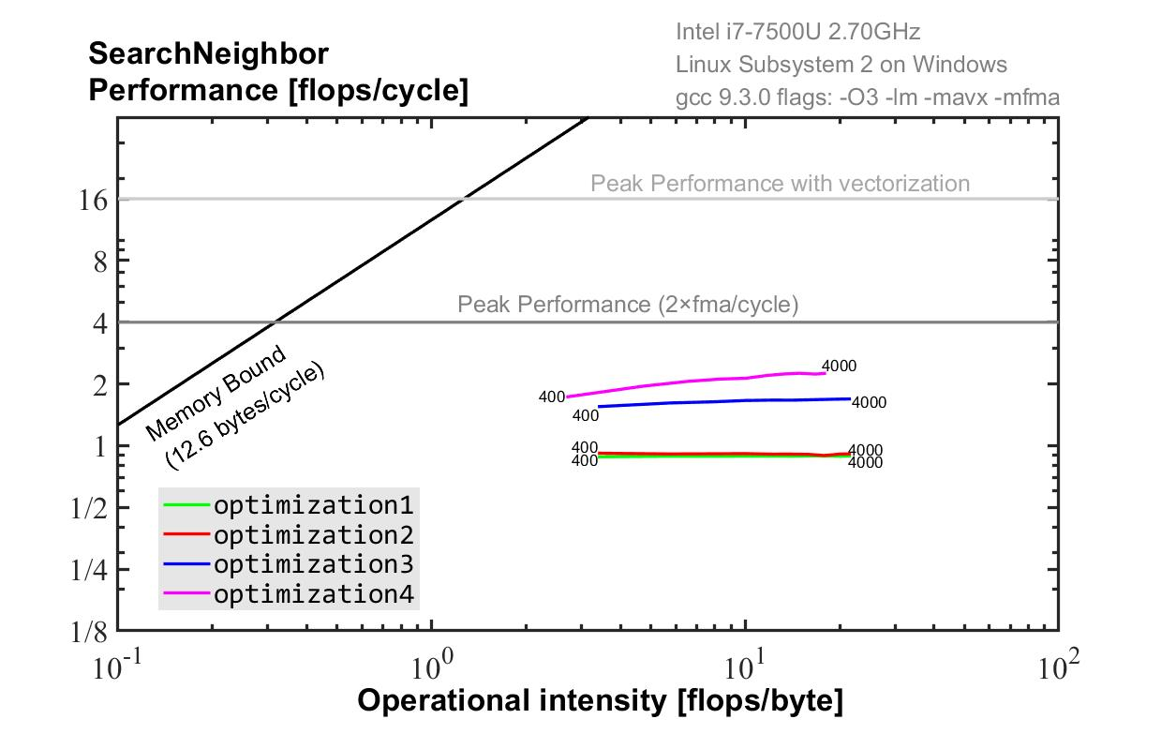
Roofline Model
Notes:
The memory transfer is theoretical. This means that the operational intensity in the plot is not so correct.

Slide 9
Discussion & Conclusion
Optimization1 VS optimization2
Real bottleneck in SearchNeighbors: a lot of branches

